Slide 1

Weather or Not: Bay Area VTA Ridership Forecasting
Group 6
Neha Thakur (017442906)
Nivedita Venkatachalam (017462276)
Rutuja Kokate (017453865)
Saumya Varshney (017417283)

Slide 2

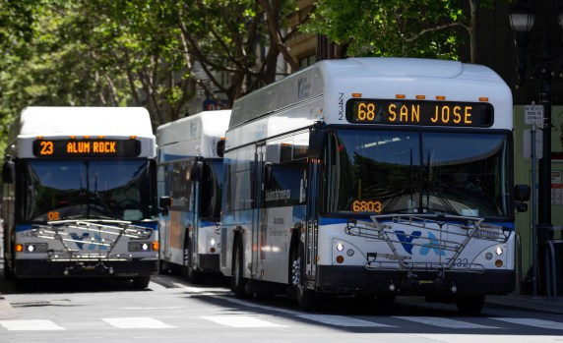
What is VTA?
Valley Transportation Authority, is responsible for managing public transportation in the Bay Area, and has observed a notable surge in ridership in recent years.
Weather conditions can fluctuate ridership demand.
Source: https://www.vta.org/blog/second-year-strong-ridership-growth#:~:text=VTA%20bus%20ridership%20increased%20by,growth%20was%2015%25%20in%202023.

Slide 3
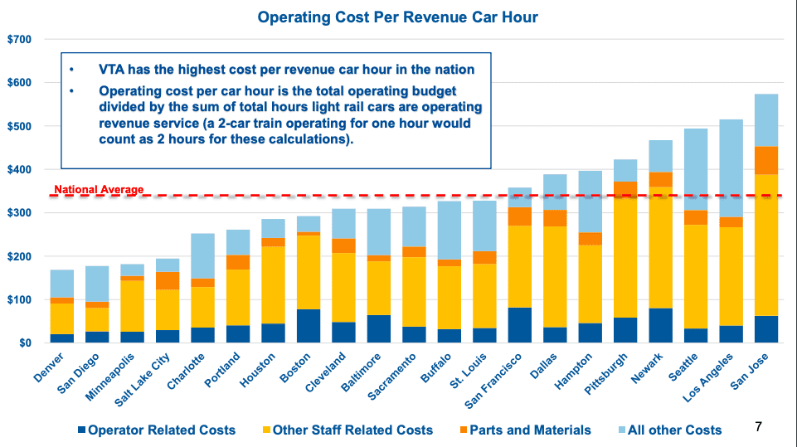
Why VTA?
VTA's operating costs rank fifth highest nationally, 35% above the average.
An average passenger vehicle emits 4.6 metric tons of CO2 annually.
Source: https://sanjosespotlight.com/san-jose-silicon-valley-transit-agency-vta-future-may-be-falling-off-the-rails-light-rail-train/ https://www.epa.gov/greenvehicles/greenhouse-gas-emissions-typical-passenger-vehicle#:~:text=typical%20passenger%20vehicle%3F-,A%20typical%20passenger%20vehicle%20emits%20about%204.6%20metric%20tons%20of,8%2C887%20grams%20of%20CO2.

Slide 4
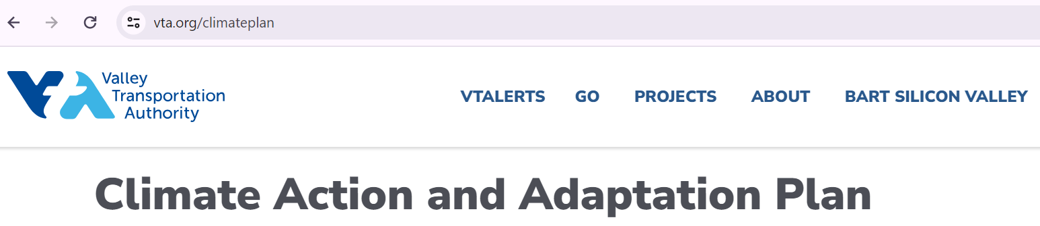

Goal is to..
Leveraging predictive power of Machine learning to
Identify how weather conditions impact ridership.
Suggesting optimization of VTA's/Transport Schedules thereby reducing greenhouse emissions.
Saving cost, energy and Co2 emissions
Source - https://www.vta.org/climateplan https://www.vta.org/programs/sustainability

Slide 5
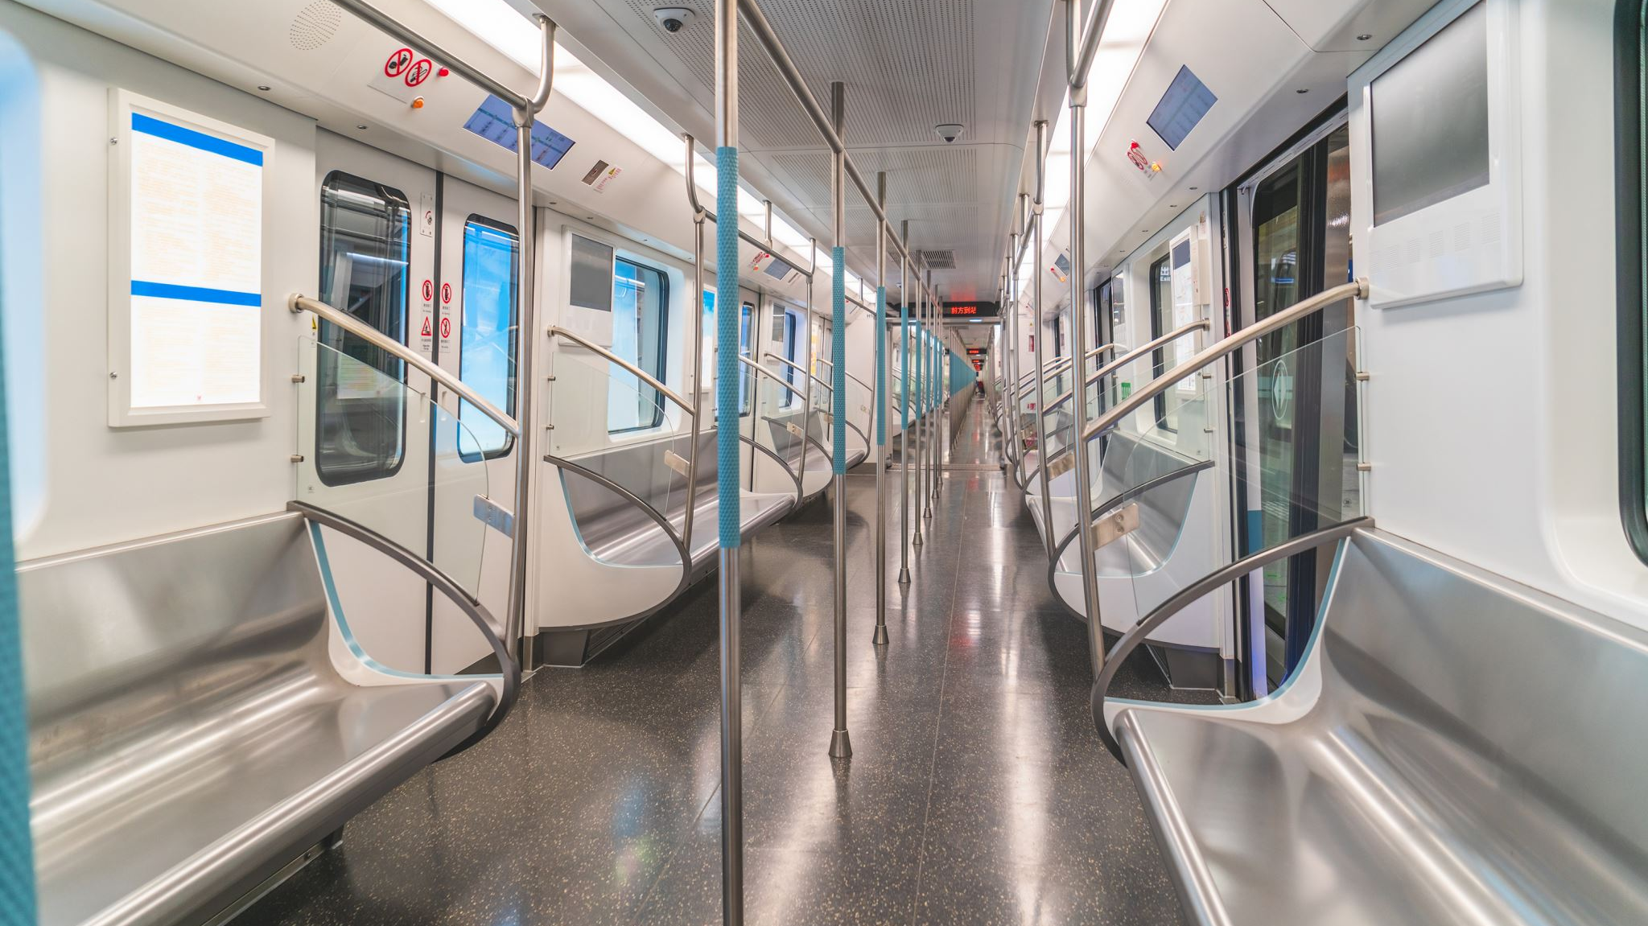

Dataset
Ridership Dataset is sourced from https://data.vta.org/
Weather Data: https://noaa-ghcn-pds.s3.amazonaws.com/
Source: https://dot.ca.gov/cal-itp/california-minimum-general-transit-feed-specification-gtfs-guidelines-v2_0#:~:text=The%20General%20Transit%20Feed%20Specification,produced%20by%20U.S.%20transit%20agencies.

Slide 6
Innovation
Overcame dataset inconsistencies through feature aggregation and Weather data Integration.
Employed diverse machine learning models to enhance prediction accuracy.
Analyzed qualitative data to discern weather's impact on travel behavior.

Slide 7
Methodology
Data Collection
Data Pre-processing
Evaluation
Inference
EDA
Modelling

Slide 8
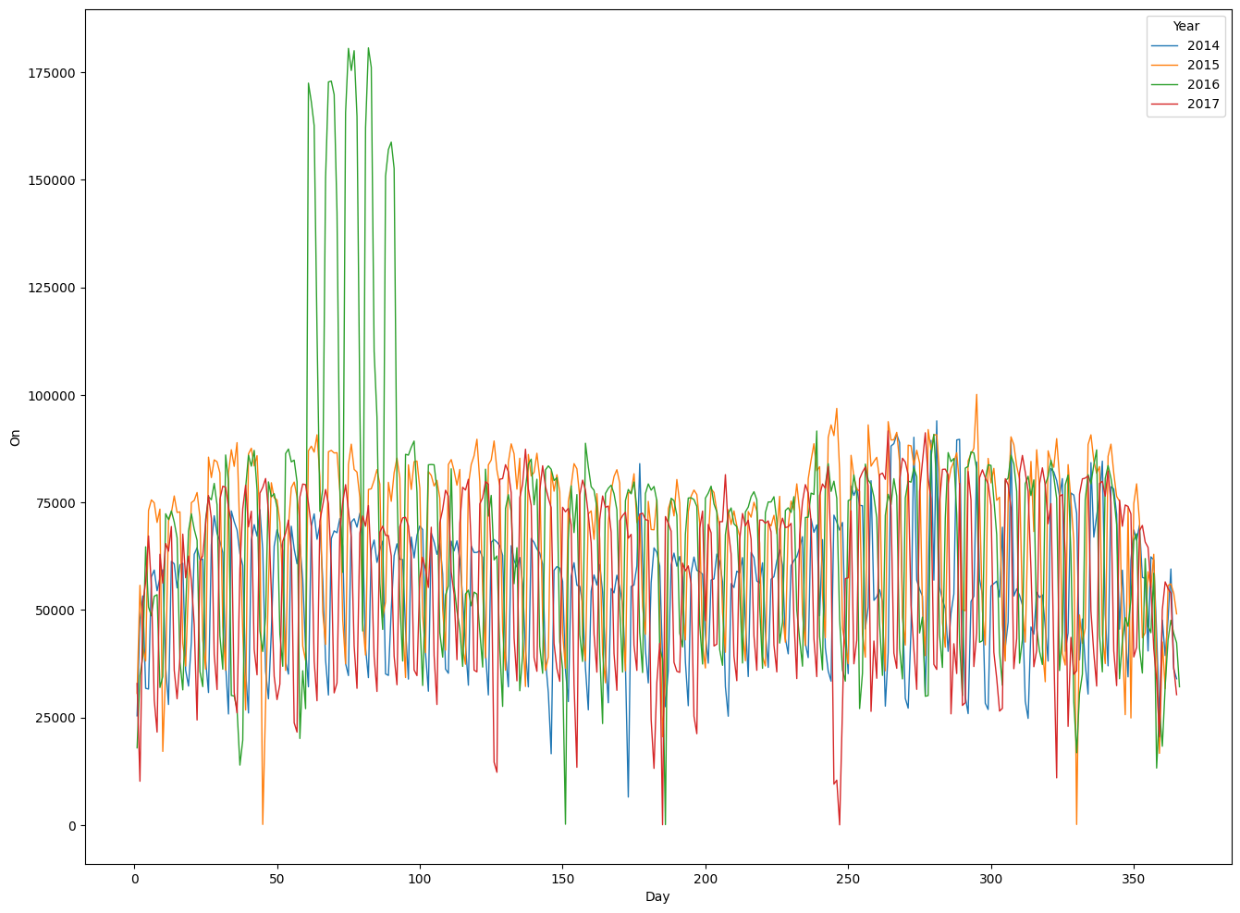
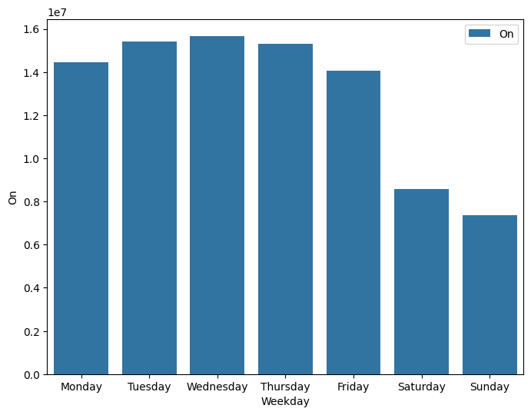
Exploratory Data Analysis

Slide 9
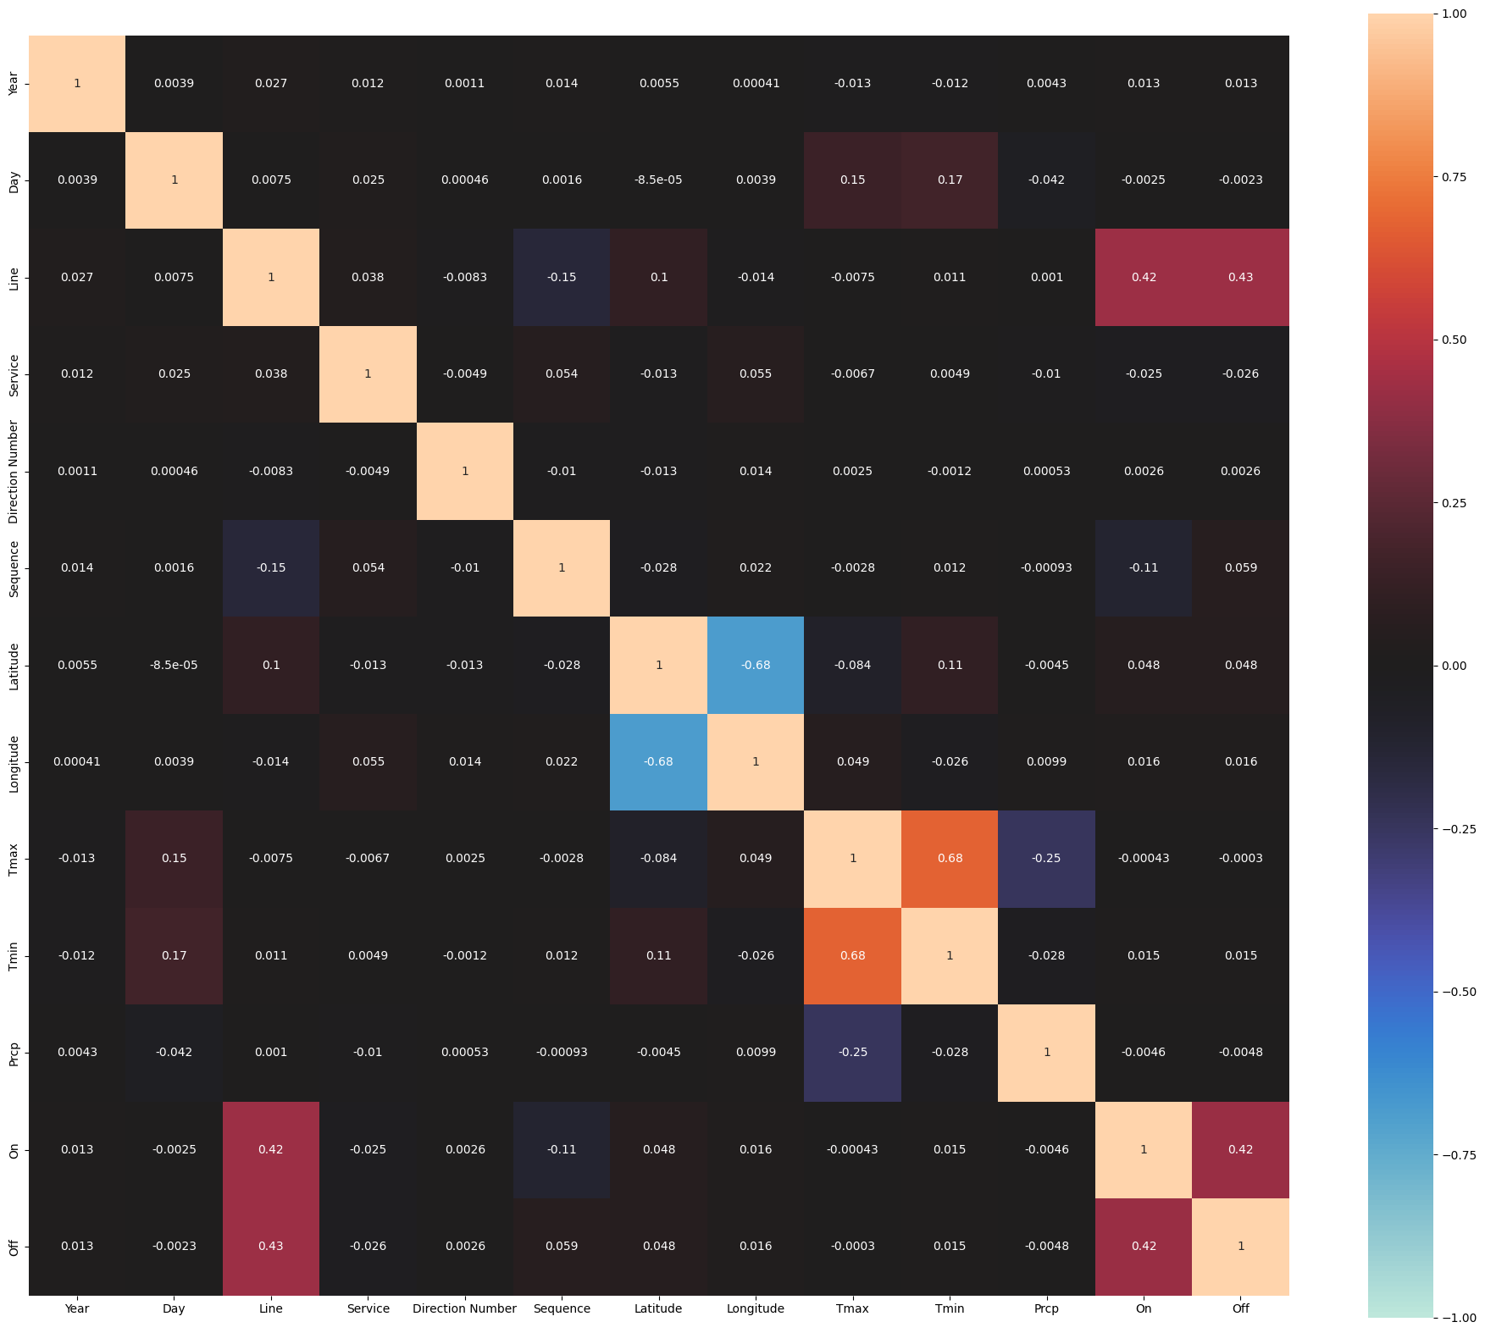
Correlation Matrix
Negative correlation:
latitude vs. Longitude
Positive correlation:
Tmax vs. Tmin
Slight negative correlation:
Tmax vs. Precipitation
Positive correlation:
on vs. Off
Significant correlation:
line vs. on/off

Slide 10
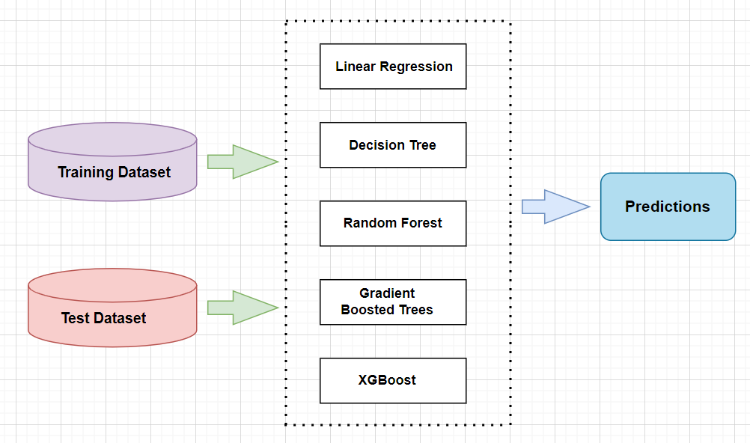
Modelling
To predict the impact of weather on VTA ridership, we utilized a diverse array of regression models spanning from basic to sophisticated techniques.

Slide 11
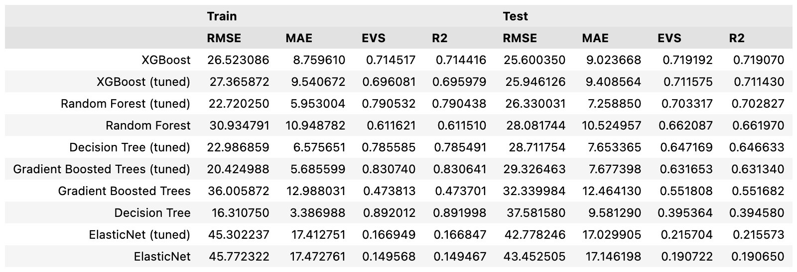
Results and Comparison of Model performance (Without Weather)

Slide 12
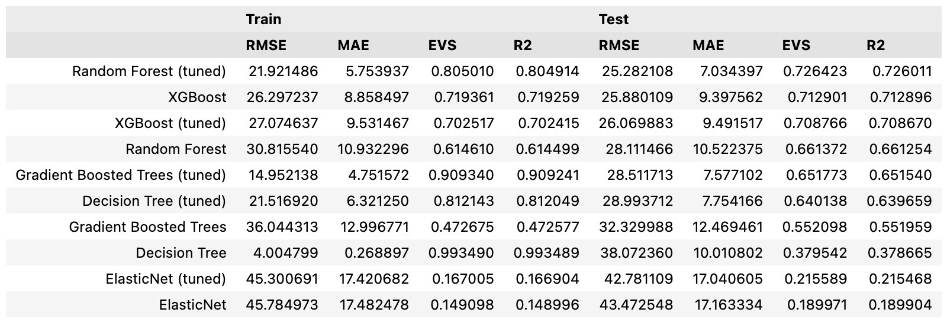
Results and Comparison of Model performance (With Weather)

Slide 13

Best Performing Model is.....
 | Train | Test
MAE | 5.75 | 7.03
RMSE | 21.9 | 29.28
EVS | 0.80 | 0.72
R2 | 0.80 | 0.72
Source: https://medium.com/almabetter/xgboost-a-boosting-ensemble-b273a71de7a8

Slide 14
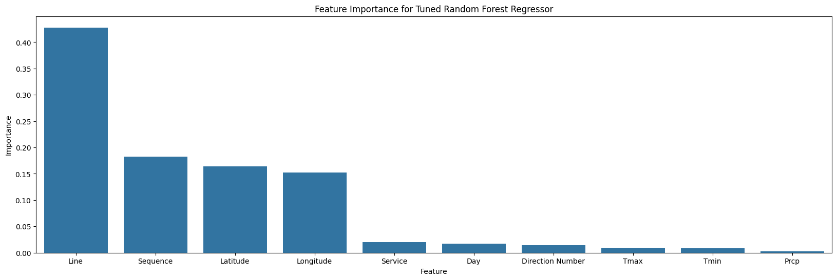
Final Model - Random forest with tuned hyperparameters
RMSE | 21.7712
MAE | 5.7359
EVS | 0.8051
R2 Score | 0.8050

Slide 15


Slide 16

Demo Time!

Slide 17
Lesson's Learnt
Key learnings:
Dealing with Huge datasets and compute resource requirements.
Integrating Multiple Datasets.
Data Imputations and its impact on model's performance.
Comparing model performance across various metrics.
Ensemble methods are sophisticated and yield much better results.

Slide 18
Conclusion
VTA Ridership prediction model can be a helpful tool for VTA authorities to save costs and make an ecological impact.
Ensemble Models provide the best results when this problem is modeled as a Regression task.

Slide 19

THANK YOU!!

Slide 20
Thank You

